Slide 1
Information Censorship and the Role of Information Technology (Literature Review)
Dr. Edward Santiago, DBA, MPM, ITIL
SUNY Sullivan Community College
October 11, 2019
Given at:
20th iSteams Conference 2019 - Kean University

Slide 2
Agenda
Information bias and censorship
The polarization of a country
Why this has happened?
The coverage of events by established news outlets
The role that information technology plays
Questions

Slide 3
Information Censorship
It has been proven that the more information is censored or prohibited, the more people are going to want it (Hobbs, 2018).
The censorship of individuals' rights to access information can lead to greater psychological reactance (reaction) (Ng, 2019).
Also, the same study concluded that people's reaction to censorship depends on the source imposing it (2019).

Slide 4
The Cultural Impact
People from different regions of the world react differently toward censorship
Importance of Censorship
Authority Imposing Censorship
Psychological Reactance

Slide 5
Culture and Censorship
Mostly of non-Western countries live in close communities, close to their relatives, or even in a tribal community where their sense of independence or of self comes last (Ng, 2019, p. 5).

Slide 6
Counties with Limited Internet
Belarus - 71.1% of its population (www.CIA.gov)
In 2006, 2007 and 2008, Belarus was listed as an “Internet enemy” by Reporters Without Borders (RWB). The government of Belarus uses controls and policies to manage Belarus’ national information space. Before 2006, most places in Belarus did not have access to broadband internet of any kind. Today, Minsk, the capital of Belarus, is the most connected place in the country with internet access in rural areas being limited.
Source: https://www.worldatlas.com/articles/are-there-countries-without-internet-access.html

Slide 7
Counties with Limited Internet
Burma – 25% of its population (www.CIA.gov)
Myanmar, formerly known as Burma, has had internet access since the beginning of 2000. However, there was a lot of censorship courtesy of the military government which significantly reduced in September 2011. Outside of the city centers, internet access in Myanmar is extremely cost-prohibitive.
Source: https://www.worldatlas.com/articles/are-there-countries-without-internet-access.html

Slide 8
Counties with Limited Internet
Cuba – 38.8% of its population (www.CIA.gov)
Internet was introduced to Cuba in the late 90s but stagnated for various reasons, including lack of funding and tight government restraints. There however still is extensive censorship with the government tightly controlling the internet. Currently, less than half of the country's population has access to the internet. Notably, it is not possible to use mobile internet in the country.
Source: https://www.worldatlas.com/articles/are-there-countries-without-internet-access.html

Slide 9
Counties with Limited Internet
Egypt – 44.3% of its population (www.CIA.gov)
Under the rule of Hosni Mubarak, the internet is Egypt was rated as being "partly free". When protest began on 25th January 2011, Twitter and Facebook were blocked, and two days later reports claimed that accessibility to the internet had been shut down. In 2017, 62 websites were banned.
Source: https://www.worldatlas.com/articles/are-there-countries-without-internet-access.html

Slide 10
Counties with Limited Internet
North Korea - ??? of its population (www.CIA.gov)
Although the internet is available in North Korea, it is strictly limited. Permission is with special authorization, mainly for government reasons. Access to the global internet is limited to a smaller group.
Source: https://www.worldatlas.com/articles/are-there-countries-without-internet-access.html

Slide 11
Counties with Limited Internet
Syria – 31.9% of its population (www.CIA.gov)
Syria has banned various websites for political reasons besides arresting people that access them. Internet connectivity was shut down late in November 2011, then ten times in 2013 and 2014.
Source: https://www.worldatlas.com/articles/are-there-countries-without-internet-access.html

Slide 12
Counties with Limited Internet
Tunisia – 50.9% of its population (www.CIA.gov)
The internet was formerly censored in Tunisia, but after the ousting of President Zine Ben Ali, censorship reduced significantly. The new government also removed filters on social networking sites.
Source: https://www.worldatlas.com/articles/are-there-countries-without-internet-access.html

Slide 13
Counties with Limited Internet
Turkmenistan – 18% of its population (www.CIA.gov)
The press and communication system of Turkmenistan is state-controlled. The telecom market remains very small, although the country began accessing internet in 1997.
Source: https://www.worldatlas.com/articles/are-there-countries-without-internet-access.html

Slide 14
Counties with Limited Internet
Uzbekistan – 46.8% of its population (www.CIA.gov)
Uzbekistan first had its internet towards the end of 1995, but the growth has been slow. Besides, there are heavy restrictions and strict controls.
Source: https://www.worldatlas.com/articles/are-there-countries-without-internet-access.html

Slide 15
Counties with Limited Internet
Vietnam – 52% of its population (www.CIA.gov)
Vietnamese internet accessibility is blocked by the government, especially to sites that are critical to the government. Information about overseas political opposition, religious topics or human rights is also blocked.
Source: https://www.worldatlas.com/articles/are-there-countries-without-internet-access.html

Slide 16
Counties with Limited Internet
China
Even though China accounts for the higher number of Internet users (around 53% of its population), its censorship has skyrocketed (Mercy, 2018). The censorship in China is guided by government policies and technology that blocks content from users this initiative is known as the Great Firewall of China (Brett, 2016). Some of the American Internet technology organization’s such as Google, have had its legal challenges imposed by China’s policy on information.

Slide 17
Counties with Limited Internet
Iran – 44.1% of its population (www.CIA.gov)
As per the World Atlas (2018), Iran’s Internet access can be slowed down due to any civil unrest of the mere fear of one. As cited by Ng (2019), Iran sees Internet access and social media as a threat to its national security, therefore, websites such as Twitter and Facebook are banned. It is noted, that Iran is a country that mostly follows the religion Islam, therefore, their threshold on sustaining censorship can be much greater than countries from the West.

Slide 18
Counties with Limited Internet
Saudi Arabia – 73.8% of its population (www.CIA.gov)
Saudi Arabia, which is located in the Middle East, has issues with the freedom of information. In Saudi Arabia, some websites have been blocked and or banned for multiple reasons (Mercy, 2018). Other websites and services such as Wikipedia and Google Translate have also been blocked for the general public since the year 2006. However, there are other deeper restrictions on topics that are imposed by the Kingdom of Saudi Arabia. On a positive note, there are more academic MoU’s (Collaboration with Western Universities) than before as part of Saudi Vision 2030.

Slide 19
The United States of America
Internet users 76.2% of the population
United States First Amendment guarantees freedom of speech
But we all feel like the rules (Laws) don’t apply to everyone

Slide 20
News Bias
During the election night, CNN reporter, Dana Bash, delivered the message that Hon. Hilary Clinton had conceded to President Elect, Donald J. Trump in a way that spoke beyond the words as if it was personal to her (CNN, 2016).
Just three days after the elections, the media’s reaction to the results of the election were of negation and catastrophe. The media used words such as “catastrophic” (Fox News, 2016) and news anchors questioning the President’s ability and mental health as Commander in Chief (Fox News, 2016).
Notes:
Too emotional to be neutral

Slide 21
Hollywood Bias
During the 2011 Correspondents’ Dinner, comedian Seth Meyers began what would be the “Hollywood Avalanche” against President Trump with this remark; “I assumed he was running as a joke” (Fox News, 2016).
Following that remark, the endless events and situations where the “Trump Supporters” were ridiculed on live television (Fox News, 2016).
The polarization of society continued, and this never leads to a good outcome.
This is a big contrast with past electoral events that the nation always backed the winner of the elections.

Slide 22
The “Beginning of the End” and the Impeachment Trials
Ever since the fitful November 8, 2016, the media was flooded with the word “Impeachment”.
Van Johns, a CNN contributor described the events as “a sad night” and “you cannot polish this turd” among other words (Fox News, 2016).

Slide 23
Collective Voice on Both Sides
The synchronization of efforts and talking points from both sides of the aisle which resembles a sporting event, two sides (Fox News, 2019) (CNN, 2018).

Slide 24
Journalism Code of Ethics
“Remain free of associations and activities that may compromise integrity or damage credibility.” (US Press Association, 2019)

Slide 25
Journalism Code of Ethics
“The news organization should strive for impartial treatment of issues and dispassionate handling of controversial subjects. It should provide a forum for the exchange of comment and criticism, especially when such comment is opposed to its editorial positions. Editorials and expressions of personal opinion by reporters and editors should be clearly labeled. Advertising should be differentiated from news.” (Associated Press Media Editors, 2015)

Slide 26
Journalism Code of Ethics
The news organization should report the news without regard for its own interests, mindful of the need to disclose potential conflicts. It should not give favored news treatment to advertisers or special-interest groups.” (Associated Press Media Editors, 2015)

Slide 27
Web Browsers Manipulation
Internet users are targeted by ads based on their online behavior.
In research using Google News, demonstrated that the majority of the results were negative toward chiropractic practice (Al-Azdee, 2018).
Chiropractic discipline is not recognized as a medical practice.

Slide 28
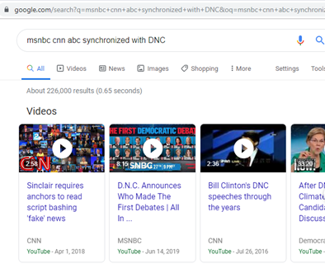
Web Browsers Manipulation
Searching for: “MSNBC, CNN, ABC, synchronized with DNC”.

Slide 29
Do as I say, Not as I Do
The weaponizing the government to spy on political rivals
The President caught on a “hot mic”
Vice President admitting to pressuring the Ukrainian President
Compare video footage of the same individuals (politicians) during President Clinton’s impeachment trial and now (TheDC Shorts, 2019).
Also, the collusion narrative seemed to be one-sided as well, but the other side had many documented wrongdoings that indicate their own collusion (CBS, 2012).

Slide 30
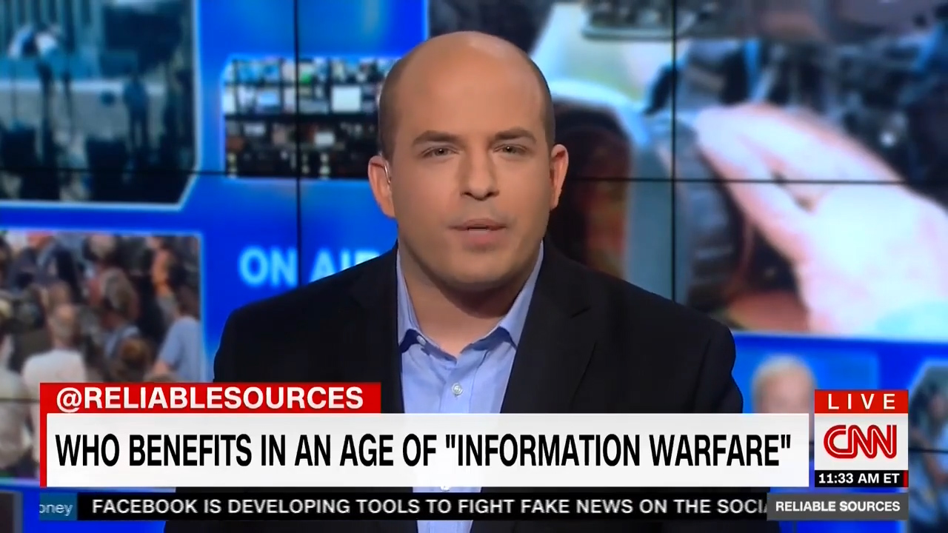
Who can you trust?

Slide 31
The Role of Information Technology
Information technology is here to stay
Now organizations and people have a virtual persona (presence) that can get them in trouble.
Many governments have implemented surveillance systems that work 24/7 to monitor areas and now, to keep track of its citizens (Reynolds, 2019, p. 27).
Employees are constantly monitored (2019).
The information technology profession observes its ethical behavior.

Slide 32
The Role of Information Technology
Information technology professionals deliver products or services.
Our duty to promote the safe and ethical digital environment
There is an extreme dependence on computer systems
Every program that is written and system that is built can have catastrophic consequences

Slide 33
The Role of Information Technology
Information technology has a high grade of continuous improvement and education
Moore’s Law (1965)
IT professionals have a code of ethics that promotes the commitment to continuous improvement
Thus, ensuring that IT professionals have at least a basic set of skills for performing its job

Slide 34
Proposed Study
Proposed questions:
Can citizens trust the news?
Is the United States subject to information censorship?
Is there a “Deep State” in the US?

Slide 35
Proposed Study
Variables:
Importance of Censorship (Dependent)
Authority Imposing Censorship (Independent)
Psychological Reactance (Dependent)
A Likert analysis would be done by presenting situations where the user evaluates each variable using a scale. This would be done using the Survey Monkey app in the northern region of the State of New York.
Ng, A. K. (2019, March). Cultural differences in psychological reactance: Responding to social media. Current psychology, 1-10. doi: https://doi.org/10.1007/s12144-019-00213-0

Slide 36
Hypothesis
H0: Information is not censored in the United States.

Slide 37
Questions?
Dr. Edward Santiago, DBA, MPM, ITIL
esantiago@SUNYSullivan.edu
Edward.Santiago@CSUGlobal.edu

Slide 38
References
Al-Azdee, M. P. (2018, December). Biased online media coverage: chiropractic and stroke in google news. Chiropractic & Manual Therapies, 26(21). doi:https://doi.org/10.1186/s12998-018-0189-8
Associated Press Media Editors. (2015). Ethics Statement. Retrieved from Associated Press Media Editors: https://www.apme.com/page/EthicsStatement
Brett, J. P. (2016). A New Approach to China: Google and Censorship in the Chinese Market. In Technology Management, Crisis Management, Negotiation. Kellogg School of Management. doi:http://dx.doi.org/10.4135/9781473970540
CBS. (2012, March 26). Obama's open mic slip on missile defense system. YouTube. Retrieved from https://www.youtube.com/watch?v=keXx0zxTarE
CNN. (2016, December 26). Top 10 election moments of 2016. CNN. Retrieved from https://www.youtube.com/watch?v=jwH68zQ4INQ
CNN. (2018, April 1). Sinclair requires anchors to read script bashing 'fake' news. Retrieved from https://www.youtube.com/watch?v=aGIYU2Xznb4
Congress of the United States. (1789). Bill of Rights. First Congress. New York: US Government. Retrieved from https://constitutioncenter.org/interactive-constitution/full-text
Fox News. (2016, November 23). Hannity: So-called unbiased media had to eat their words. Retrieved from https://www.youtube.com/watch?v=IL07je3qXvc

Slide 39
References
Fox News. (2016, November 11). Press upset with election results. Fox News. Retrieved from https://www.youtube.com/watch?v=REiEkNKIPtc
Fox News. (2019, January 9). Tucker: Democrat talking points echo across the land. Retrieved from https://www.youtube.com/watch?v=urAF4Tx_m3g
Hobbs, W. R. (2018). How Sudden Censorship Can Increase Access to Information. William R.Hobbs and Margaret E. Roberts, 112(3), 621–636. doi:doi:10.1017/S0003055418000084
Mercy, M. (2018, May 9). Are There Countries Without Internet Access? Retrieved from World Atlas: World Facts: https://www.worldatlas.com/articles/are-there-countries-without-internet-access.html
Ng, A. K. (2019, March). Cultural differences in psychological reactance: Responding to social media. Current psychology, 1-10. doi:https://doi.org/10.1007/s12144-019-00213-0
Reynolds, G. (2019). Ethics in Information Technology. Boston: Cengage Learning.
TheDC Shorts. (2019, September 25). Democrats On Impeachment - Then And Now. YouTube. Retrieved from https://www.youtube.com/watch?v=YZakBC7dt6c
US Press Association. (2019). US PRESS ASSOCIATION - JOURNALIST CODE OF ETHICS. Retrieved from US Press Association: https://uspressassociation.org

