Slide 1
EVIDENCE BASED RECONSTRUCTION
Presented by
Ellen Akongwin Abanga
ellen.abaga@st.gimpa.edu.gh

Slide 2
INTRODUCTION
Evidence is defined as “any matter of fact, the effect, tendency or design of which is to produce in the mind a persuasion of the existence or non-existence of some other matter of fact” (Routledge, 2004).
In gathering evidence for digital forensics and gaining a clear view of events and artefacts and activities that occur throughout time is a difficult task.
One of the most important and difficult challenges in digital forensics is reconstructing the chronology of events and activities, which allows digital investigators to grasp the history of digital crime and interpret the conclusion in the form of digital evidence (Bhandari & Jusas, 2019).

Slide 3
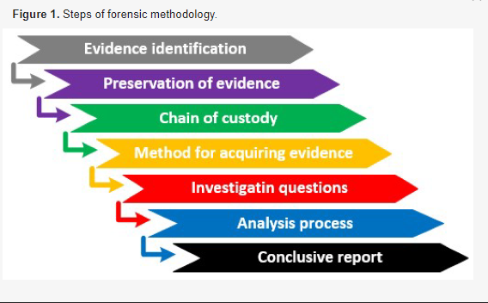
CONDUCTING EVIDENCE BASED RECONSTRUCTION

Slide 4
RESEARCH FINDINGS vs GAPS
Authors | FINDING | GAP
Buczak and Guven (2017) | The study discovered that network evaluation, machine learning and data mining approaches used to enable reconstruction had a strong association. However, he also observed that network evaluation, machine learning, and data mining technologies for intrusion detection and reconstruction are vulnerable to security risks. | He did not precisely identify the link between the two, nor did he offer particular solutions or remedies to the problems.
Jean-Paul et al., (2021) | The study uncovered forensics approaches, including computer, mobile, network, cloud, digital, malware, and e-mail forensics, as well as anti-forensics strategies and activities which help build evidence for reconstruction purposes. | The study failed to discuss describe how each approach help evidence based reconstruction individually.

Slide 5
RECOMMENDATION FOR POLICY & PRACTICE
Digital forensic investigators should be encouraged through training and be informed of evidence based reconstruction that enhance investigation techniques especially for the police. This will prevent future cybercrime.
There is the need for policies that ensure investment in Digital forensic reconstruction tools that enhance evidence gathering.

Slide 6
DIRECTION FOR FURTHER WORK
Further research is needed in the application of more evidence based methods in machine-learning-based techniques, as well as a variety of privacy-preserving solutions to prevent any evidence change caused by anti-forensics activities.

Slide 7
QUESTIONS AND CONTRIBUTIONS

Slide 8
THANK YOU

