Slide 1

THE ROLE OF SCIENCE IN ECONOMIC TRANSFORMATION AND NATIONAL DEVELOPMENT
PRESENTED AT
22ND INTERNATIONAL SCIENCE, TECHNOLOGY, EDUCATION, ARTS, MANAGEMENT & THE SOCIAL SCIENCES (Isteams) MULTIDISCIPLINARY CONFERENCE
By
Prof Mrs Olubukola Monisola Oyawoye
BSc., MSc., Ph.D, PGDE,PDFM, MMSN, MNifst, MASM, MSFAM, FNSM

Slide 2
Introduction
It is axiomatic to posit that there is a linkage between Science and National Development. This intercourse is not only symbiotically connected; but, one depends on the other for its sustenance. Therefore, the role of Science on economic transformation and national development can not be over emphasized. The wheel of development of any country lies on the shoulder of how vibrant and progressive its Science and Technology are.

Slide 3
Introduction
Developments in science and technology are fundamentally altering the way people live, connect, communicate and transact, with profound effects on economic development. To promote technology advance, developing countries should invest in quality education for youth, and continuous skills training for workers and managers.

Slide 4
Introduction
The technological revolutions of the 21st century are emerging from entirely new sectors, based on micro-processors, tele-communications, bio-technology and nano-technology. Products are transforming business practices across the economy, as well as the lives of all who have access to their effects. The most remarkable breakthroughs will come from the interaction of insights and applications arising when these technologies converge.

Slide 5
Introduction
Through breakthroughs in health services and education, these technologies have the power to better the lives of poor people in developing countries. Eradicating malaria, a scourge of the African continent for centuries, is now possible. Cures for other diseases which are endemic in developing countries are also now possible, allowing people with debilitating conditions to live healthy and productive lives.

Slide 6
Definition of Terms
Science is the intellectual and practical activity encompassing the systematic study of the structure and behaviour of the physical and natural world through observation and experiment.
Technology on the other hand is the practical application of scientific knowledge or inventions to the solving of everyday problems or facilitating tedious human activities.
The product of science and technology has contributed to the development of countries such as, America, Japan, China and to an extent in some African countries.

Slide 7
Definition of Terms
Economy refers to the state of a country or region in terms of the production and consumption of goods and services and the supply of money.
Economics can actually be defined a few different ways: it's the study of scarcity, the study of how people use resources, or the study of decision-making.
Transformation in economics refers to a long-term change in dominant economic activity in terms of prevailing relative engagement or employment of able individuals. Human economic systems undergo a number of deviations and departures from the "normal" state, trend or development.

Slide 8
Areas of Science
Industrial Chemistry
Pharmaceutical Science
Physical Chemistry
Engineering
Petroleum Chemistry
Chemistry
Physics
Mechanics
Physics Electronics
Computer Science
Biochemistry
Biology
Environmental Sciences
Biotechnology
Microbiology
Agricultural Sciences
Botany
Zoology

Slide 9
The tool for science and technology is research
Research is a tool for sustainable Development, Innovation and Wealth Creation
Research is an ORGANIZED and SYSTEMATIC way of FINDING ANSWERS to QUESTIONS.

Slide 10


Slide 11
Physics and Electronics
Physics the branch of science concerned with the nature and properties of matter and energy. The subject matter of physics includes mechanics, heat, light and other radiation, sound, electricity, magnetism, and the structure of atoms.
Electronics is the application of electromagnetic (and quantum) theory to construct devices that can perform useful tasks, from as simple as electrical heaters or light bulbs to as complex as the Large Hadron Collider.

Slide 12



Slide 13



Slide 14
Computer Science and Engineering
According to the United Nations International Telecommunications Union (UN-ITU), by the end of 2010 there were an estimated 5.3 billion mobile cellular subscriptions worldwide, including 940 million subscriptions to 3g services. About 90 percent of the world’s population can access mobile networks, with three-quarters of mobile subscribers living in developing economies.

Slide 15
Computer Science and Engineering
Cellular technology has allowed Africa to leapfrog the age of fixed line telephony, bringing affordable access to millions of people. However, the continued and equitable expansion of Information Communication Technology (ICT) depends on electricity. The real divide over the next 20 years will be between those who have access to reliable electricity to power these devices and those who do not.

Slide 16


Slide 17
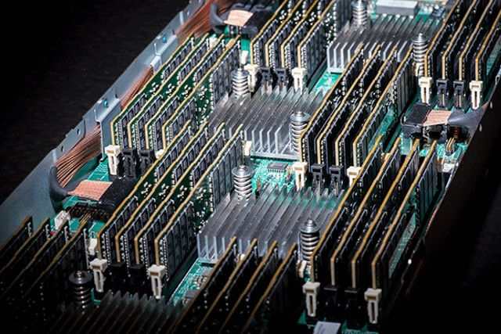


Slide 18
Computer Science and Engineering
Scientific knowledgable professionals, have been able to invent equipments and machines being used in industries and even in our homes, in addition to this science and technology has helped in easing stress, brought by the movement of goods and people from one place to another, by inventing easy transportational equipments like automobiles, aircrafts and so on.

Slide 19
Computer Science and Engineering
Other technologies under development are interventions for cognitive enhancement, proton cancer therapy and genetic engineering. Revolutionary inventions include small underground nuclear power units called nuclear batteries that will be ultra-safe and maintenance-free; new types of photo-voltaics that will make electricity from sunlight cheaper than that from coal; and myriad nano-technologies, some of which lower the cost and increase the reliability of many products – even in the poorest areas of the developing world.

Slide 20
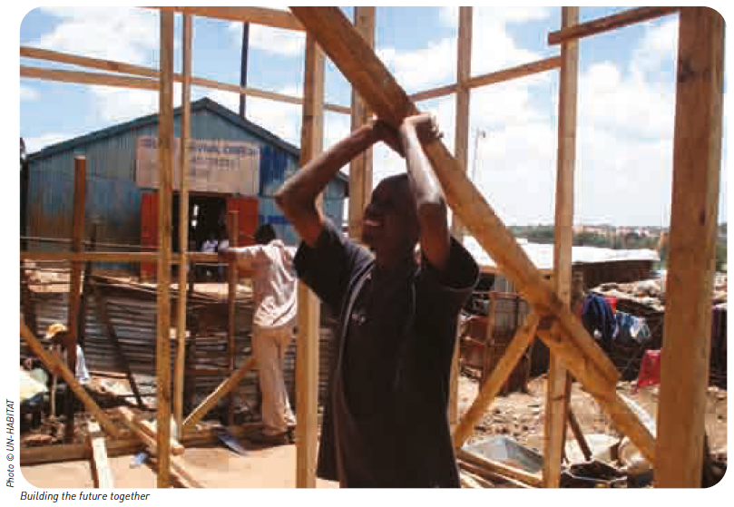

Slide 21


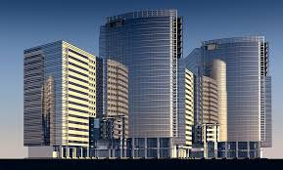
Canada, Abu Dhabi and Lagos

Slide 22

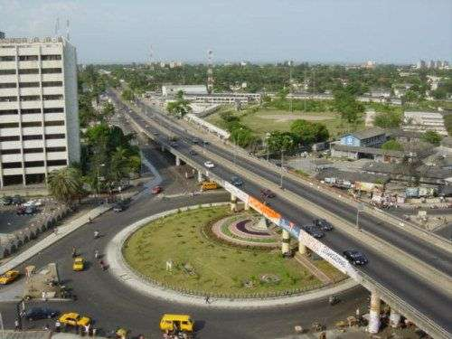
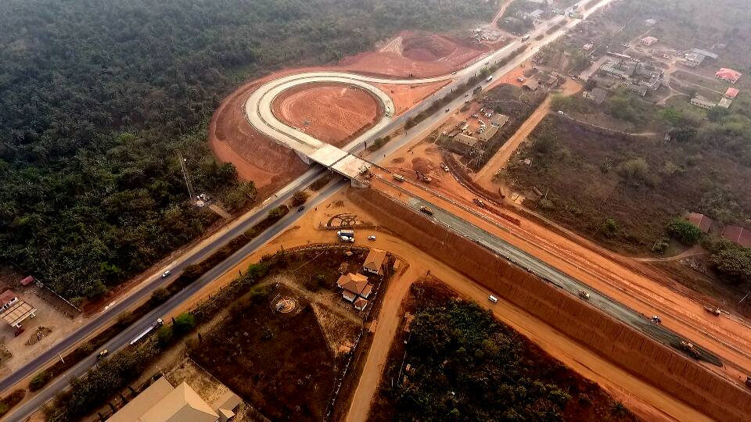
UK, Lagos and Osun Roads

Slide 23
Science and Technology
Science and technology are the differentiators between countries that are able to tackle poverty effectively by growing and developing their economies, and those that are not. The extent to which developing economies emerge as economic powerhouses depends on their ability to grasp and apply insights from science and technology and use them creatively. Innovation is the primary driver of technological growth and drives higher living standards.

Slide 24
Science and Technology
As an engine of growth, the potential of technology is endless, and still largely untapped in Africa and other developing world regions across the globe. Less developed countries not only lack skilled labour and capital, but also use these less efficiently. Inputs account for less than half of the differences in per capita income across nations. The rest is due to the inability to adopt and adapt technologies to raise productivity.

Slide 25
Science and Technology
Equally important is the fact that science and technology has helped in making work more eaiser for people to do through the invention of computers and household machinaries, it has also made communication faster, through the use of mobile phones, televisions, radio, used in communication.
Science and technology has aided so many sectors of the economy such as the advertising sector, sports and fitness (weight loss), transportation, agriculture, and so on.

Slide 26
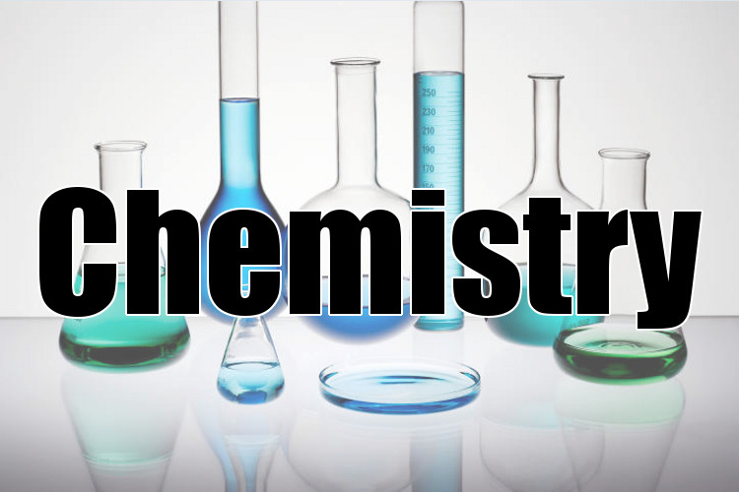
The chemical industry comprises the companies that produce industrial chemicals. Central to the modern world economy, it converts raw materials (oil, natural gas, air, water, metals, and minerals) into more than 70,000 different products.

Slide 27

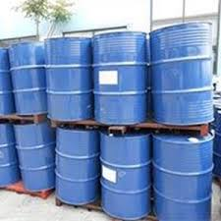
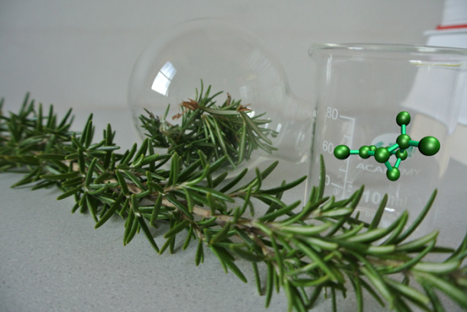
Chemical Industries and applications

Slide 28
Pharmaceutical Science
The pharmaceutical industry discovers, develops, produces, and markets drugs or pharmaceutical drugs for use as medications. Pharmaceutical companies may deal in generic or brand medications and medical devices.

Slide 29


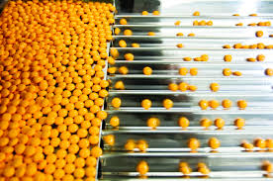


Slide 30
BIOTECHNOLOGY….
Biotechnology is the use of living systems and organisms to develop or make products, or any technological application that uses biological systems, living organisms, or derivatives thereof, to make or modify products or processes for specific use. It is simply technology based on biology. It harnesses cellular and biomolecular processes to develop technologies and products that help improve our lives and health of our planet.

Slide 31
Food/Agricultural Biotechnology
Biotechnology allow for the identification and transfer of one or few genes that confer particular benefits with high precision. It is the formation of new heritable materials by the insertion of nucleic acid molecules produced outside a cell by vector systems (Replicon) (Chawla, 1998, NCBE, 2002). The DNA to be inserted into the host (bacterium, animals or plants) may come from prokaryotic cells, Eukaryotic cells or could be synthesized chemically. It enables the transfer of genes between completely unrelated organisms.

Slide 32
Food/Agricultural Biotechnology
Food Biotechnology is the application of plant, animal and microbial systems to the production and industrial processing of food, through the development of new cultivars and livestock strains, of microorganisms with particular characteristics, and thence of new and alternative food raw materials, additives, processing aids, etc.

Slide 33

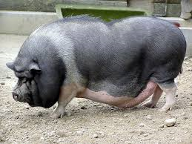

Slide 34



Slide 35
Microbiology
A microorganism or microbe is a microscopic living organism, which may be single-celled or multicellular. The study of microorganisms is called microbiology, a subject that began with the discovery of microorganisms in 1674 by Antonie van Leeuwenhoek, using a microscope of his own design.
Microorganisms are very diverse and include all bacteria, archaea and most protozoa. This group also contains some species of fungi, algae, and certain microscopic animals, such as rotifers.

Slide 36
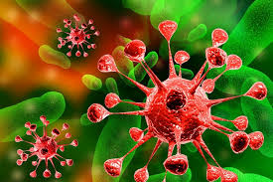
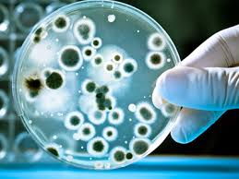
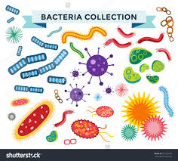
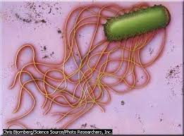

Slide 37
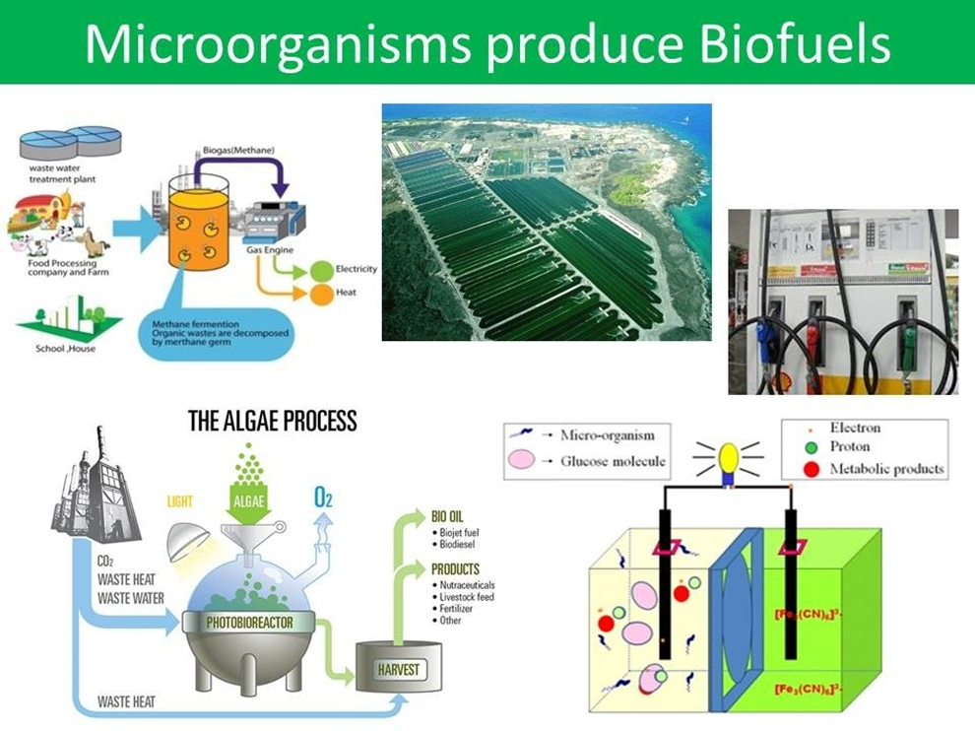

Slide 38
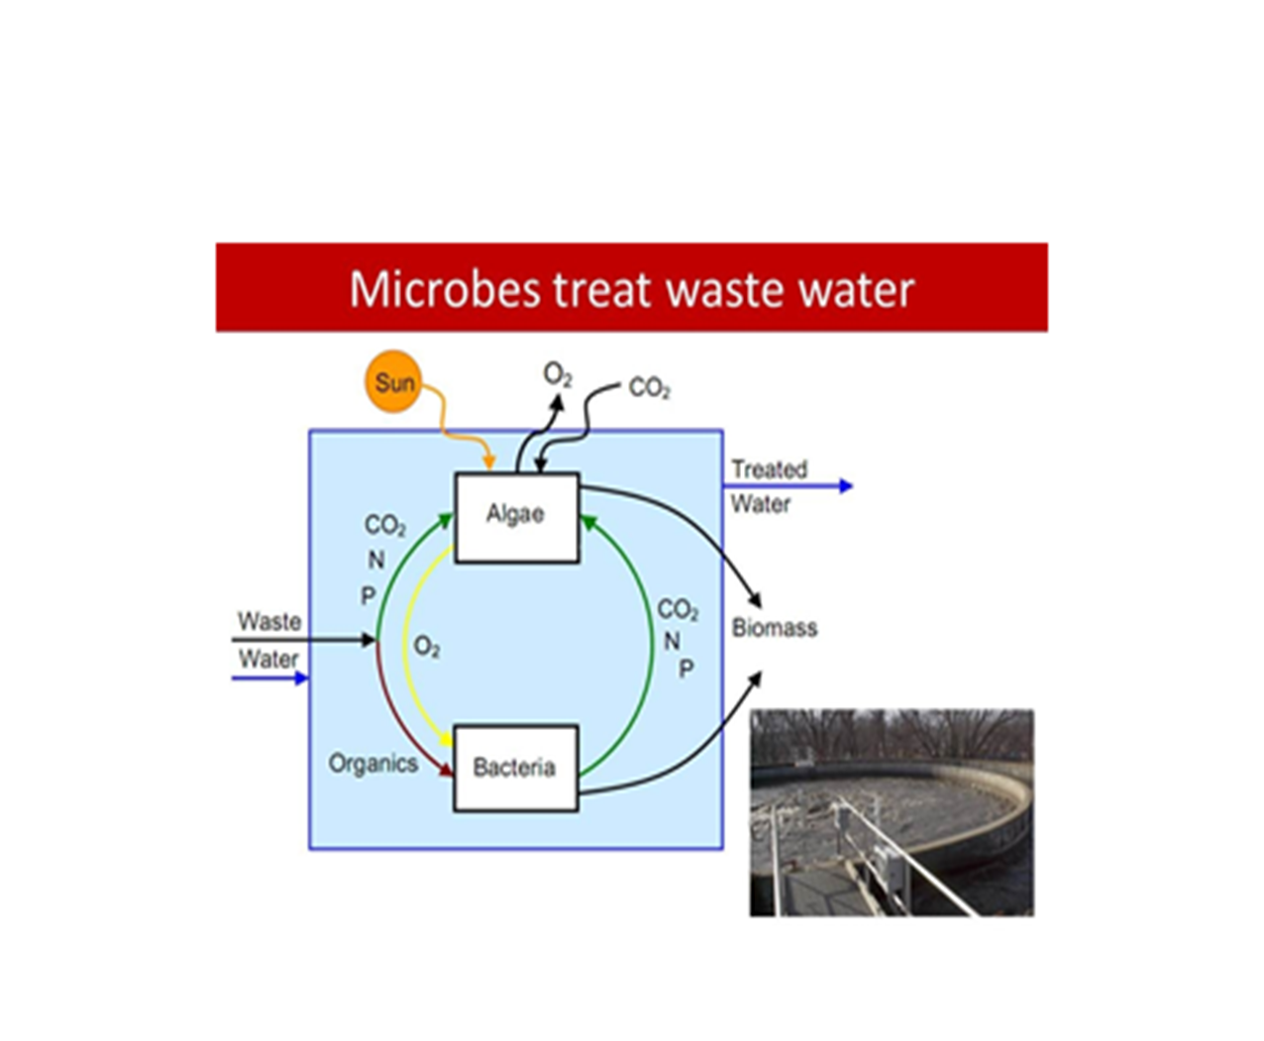

Slide 39
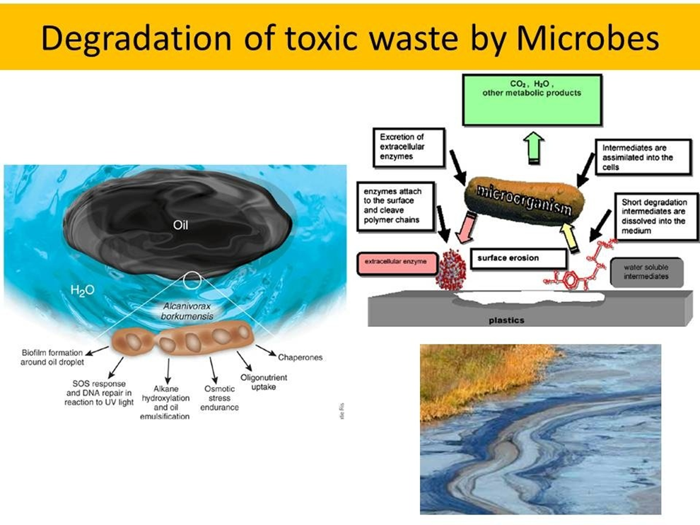

Slide 40
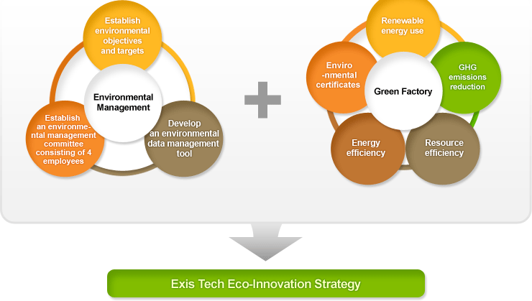

Slide 41
Biochemistry
Biochemistry is a gateway of all the branches of life science. It's a field of enormous interest and utility. Biochemistry is a study of the molecule of life. The tools of biochemistry have been used to explain biological processes such as origin of life, cell development, cell differentiation, metabolisms, energy dynamics, origin and cause of diseases and even human behaviors.

Slide 42
Biochemistry
The principles of biochemistry are now reaching into chemistry, the health sciences, nutrition, agriculture, physiology, immunology, neurology, cell biology, biotechnology, nanotechnology, ecology, computer science and psychology. Not only the biochemistry expanding; other disciplines are using the tools of biochemistry to solve their unique problem. Thus biochemistry is seated at the core of other branches of science.

Slide 43
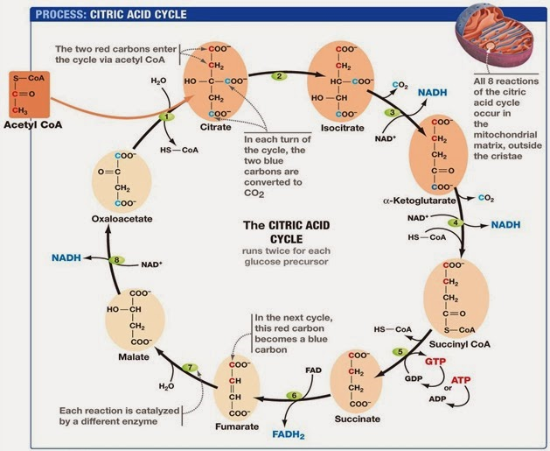

Slide 44
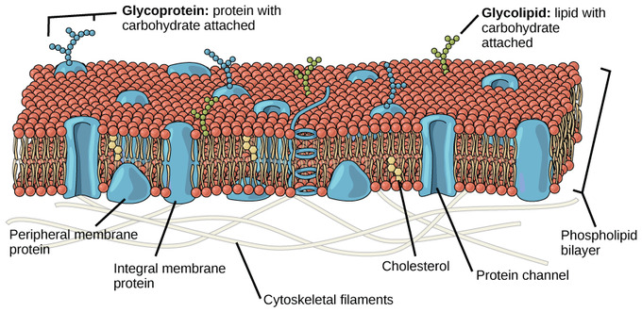

Slide 45
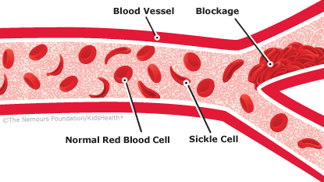
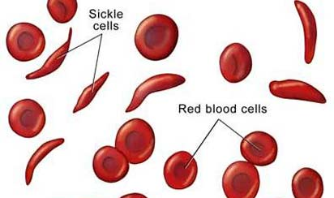

Slide 46
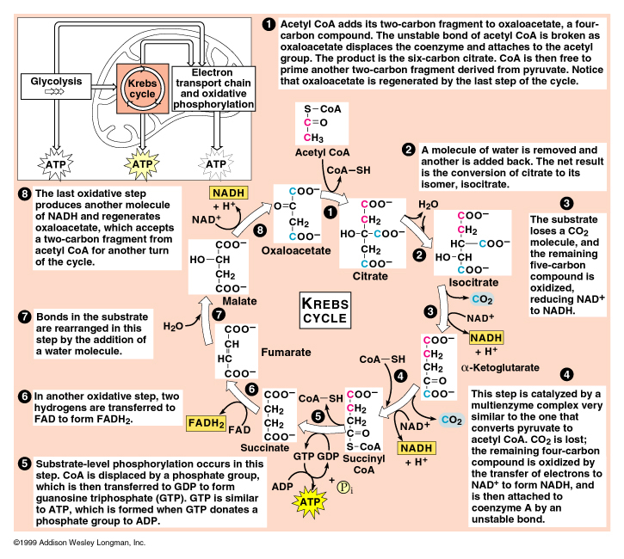

Slide 47
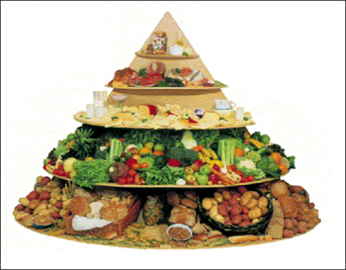


Nutritional Biochemistry

Slide 48
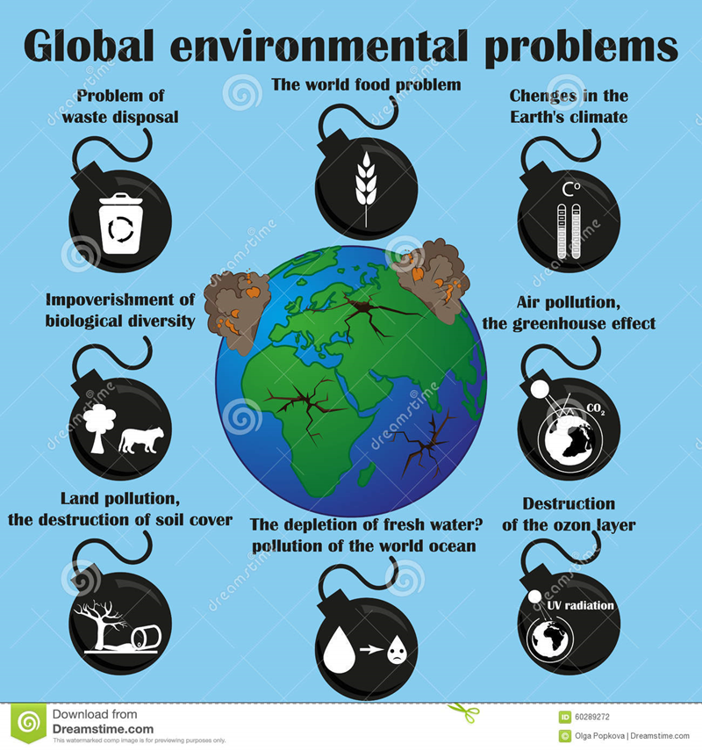
Environmental Sciences

Slide 49
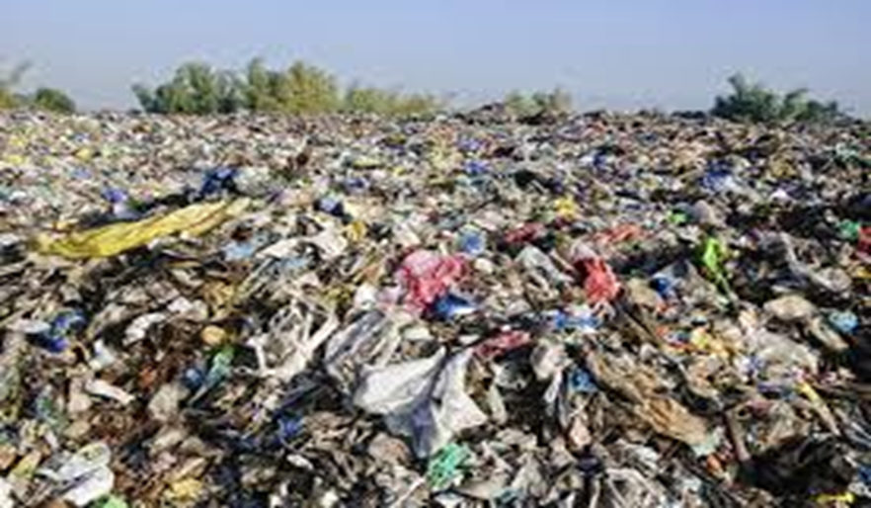

Slide 50
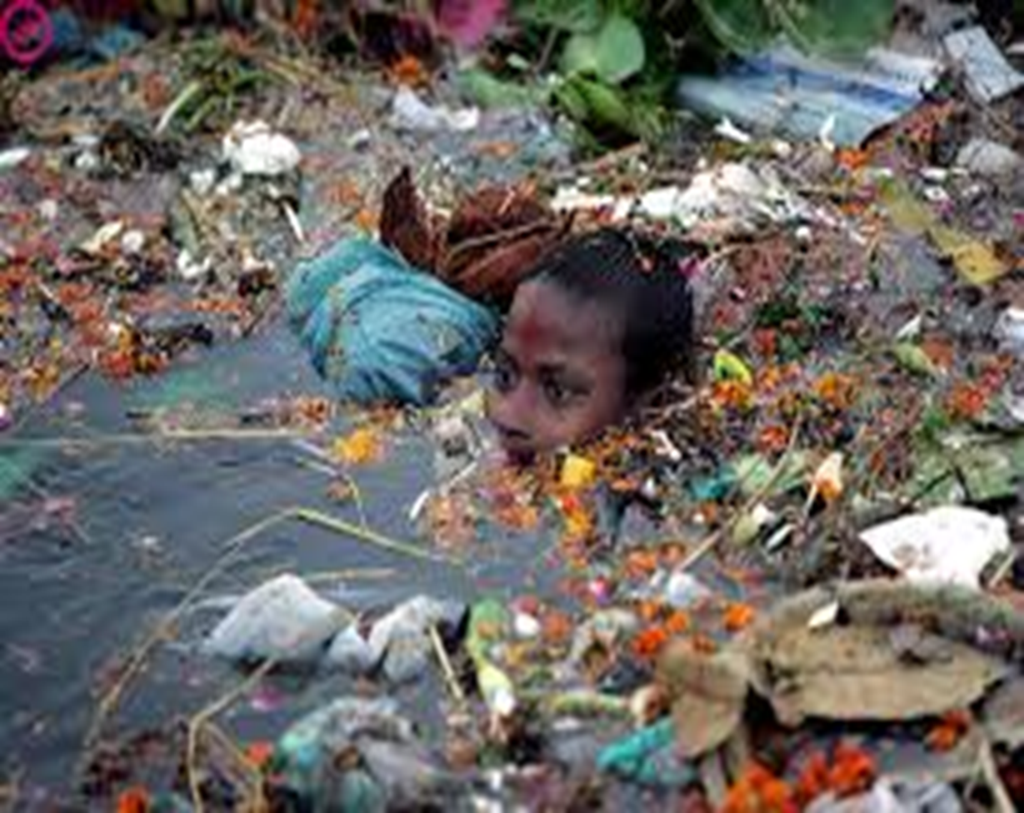

Slide 51
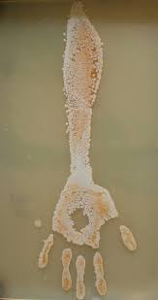
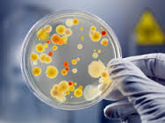
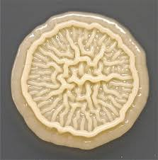
Hand and Air Pollution

Slide 52
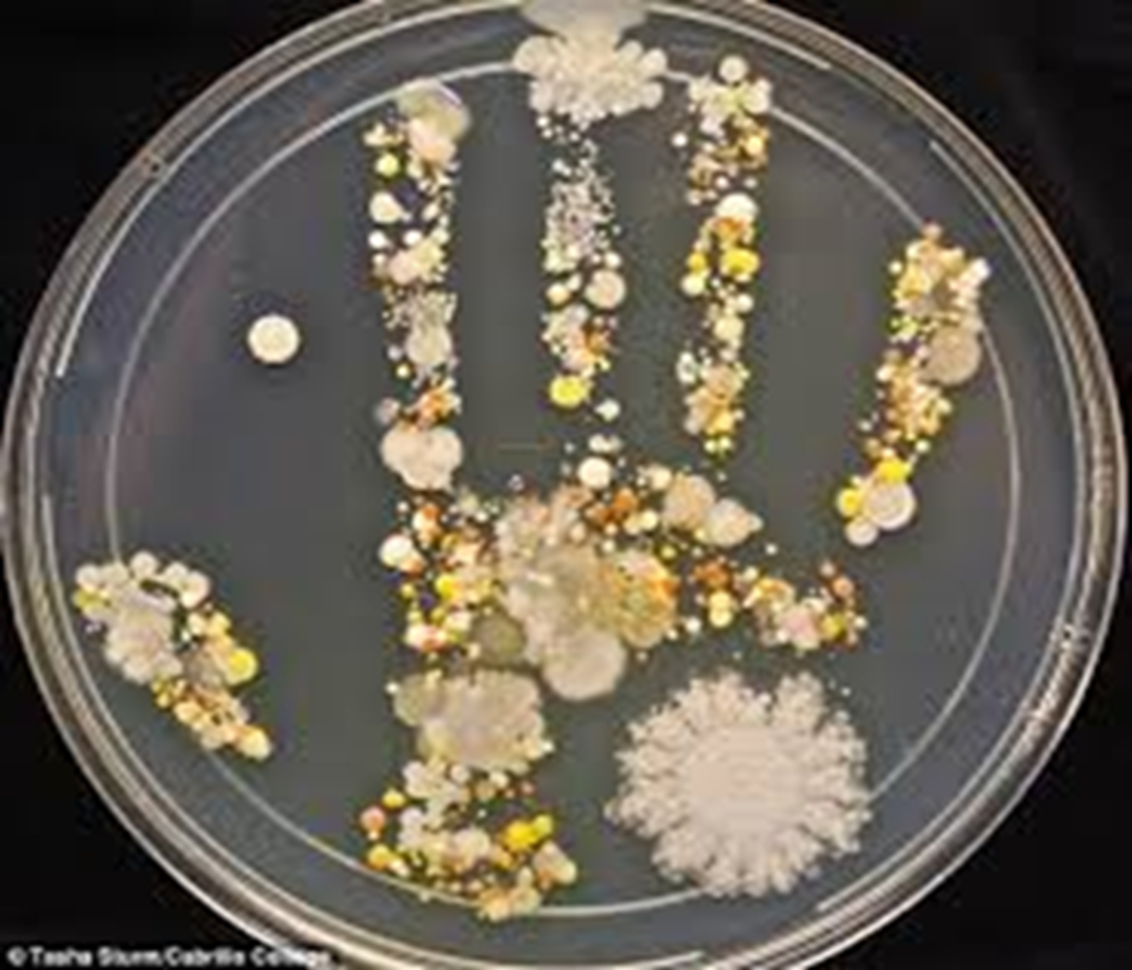

Slide 53
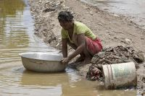
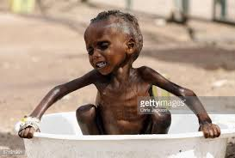
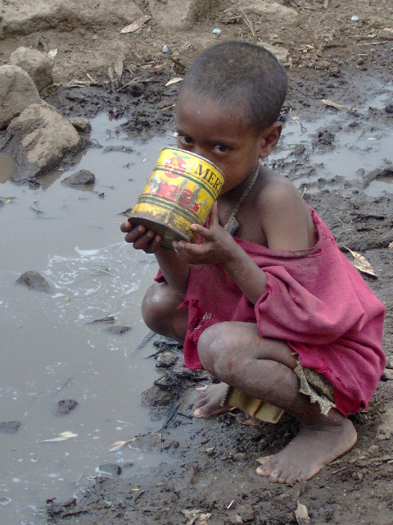
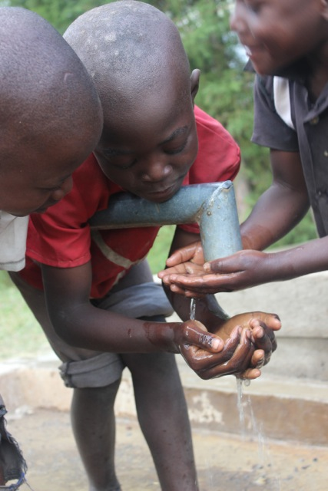

Slide 54

How our environment should look

Slide 55
Medicine
The science or practice of the diagnosis, treatment, and prevention of disease (in technical use often taken to exclude surgery).
The word "medicine" is derived from Latin medicus, meaning "a physician".Medicine encompasses a variety of health care practices evolved to maintain and restore health by the prevention and treatment of illness. Contemporary medicine applies biomedical sciences, biomedical research, genetics, and medical technology to diagnose, treat, and prevent injury and disease

Slide 56
Medicine
Certain innovations and discoveries will raise fraught bio-ethical issues, as genetic modification of food crops and cloning of human embryos has already done. There is a risk that their cost, particularly in the early stages of development, will worsen the present inequality by limiting access to wealthy individuals. This already happens in health care in certain G7 countries, where the demand for very high-cost diagnostic equipment and surgical interventions enabling longevity and better quality of life for older wealthy people overstretches public health care budgets, and lowers service quality in poor neighborhoods.

Slide 57

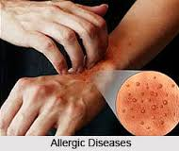

Slide 58
Medicine
Furthermore, science and technology has helped in the area of medicine. Some natural herbs converted to drugs with the aid of modern equipment and these drug are used in our hospitals and pharmacies.
Resource-intensive technologies, focused on satisfying high consumption demand, like holidays abroad in costal resorts, wilderness areas, or iconic cities, increase carbon emissions and environmental damage.

Slide 59
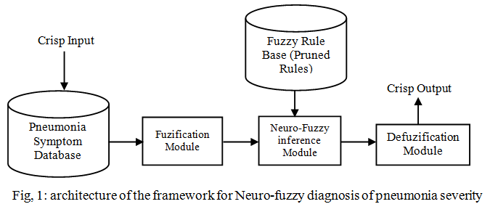
A Neuro-Fuzzy Framework for Pneumonia Severity Prediction

Slide 60
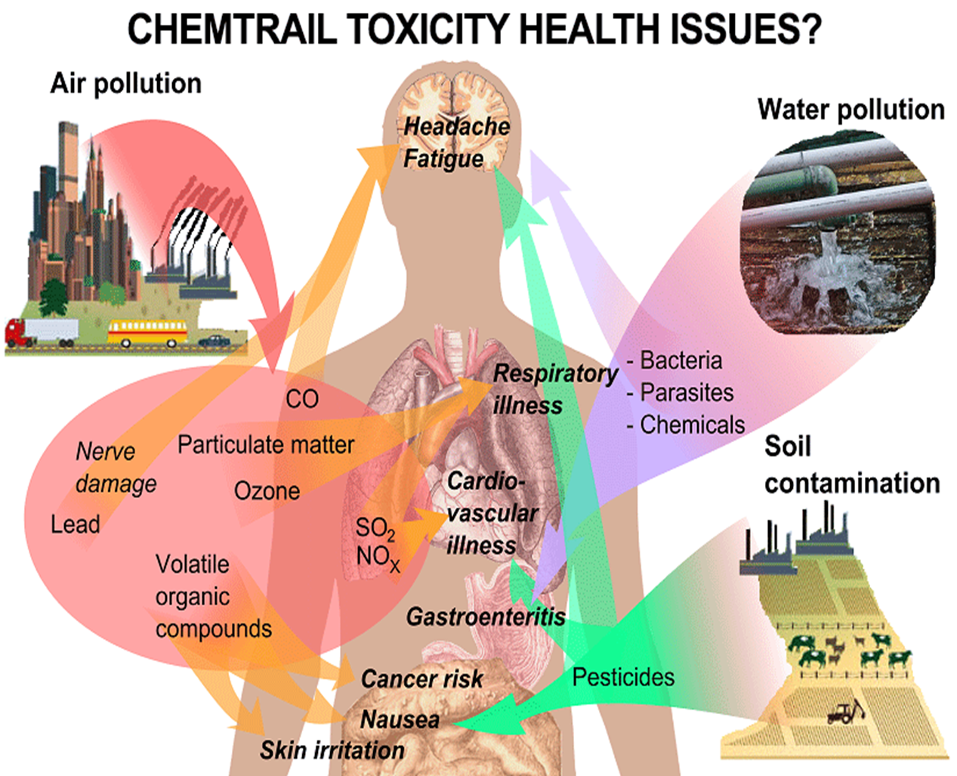

Slide 61
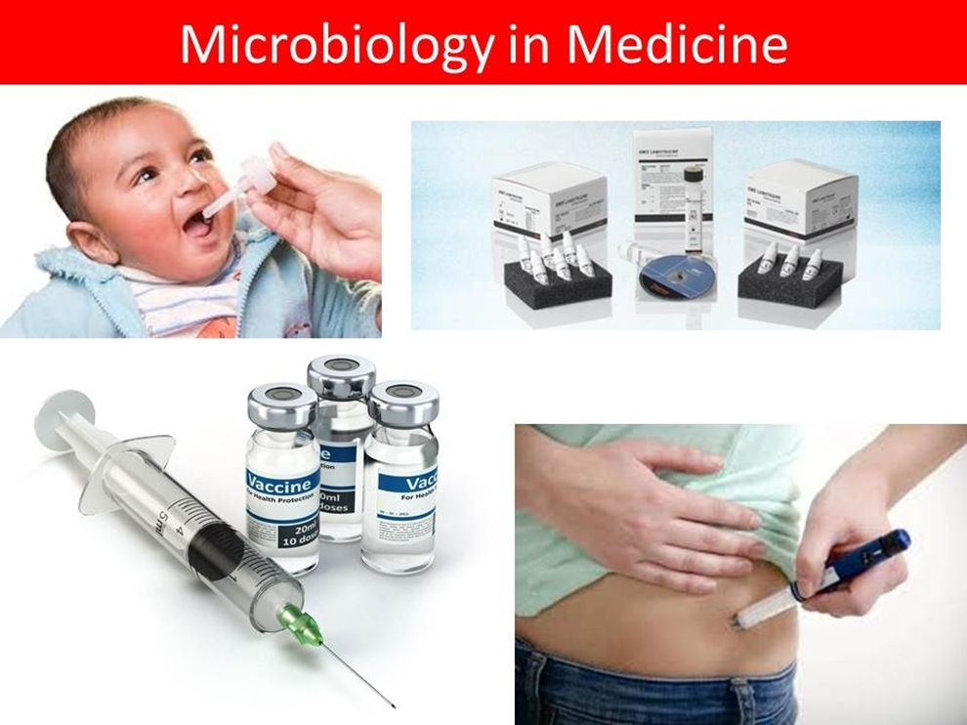

Slide 62
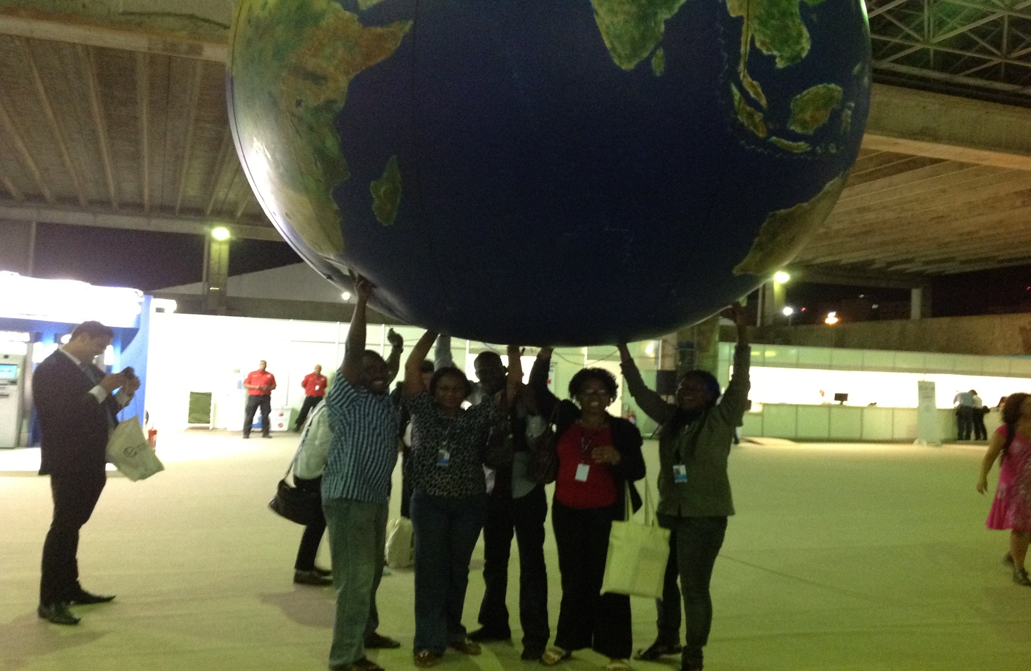

Slide 63
Technological Advancement
To promote technological advances, developing countries should invest in quality education for youth, continuous skills training for workers and managers, and should ensure that knowledge is shared as widely as possible across society.

Slide 64
Technological Advancement
In a world in which the Internet makes information ubiquitous, what codunts is the ability to use knowledge intelligently. Knowledge is the systemically integrated information that allows a citizen, a worker, a manager, or a finance minister to act purposefully and intelligently in a complex and demanding world. The only form of investment that allows for increasing returns is in building the stocks and flows of knowledge that a country or organization needs, and in encouraging new insights and techniques.

Slide 65


Slide 66
Scientific research the way out
Adopting appropriate technologies leads directly to higher productivity, which is the key to growth. In societies that have large stock and flows of knowledge, virtuous circles that encourage widespread creativity and technological innovation emerge naturally, and allow sustained growth over long periods.

Slide 67
Scientific research the way out
In societies with limited stocks of knowledge, bright and creative people feel stifled and emigrate as soon as they can, creating a vicious circle that traps those who remain in a more impoverished space. Such societies stay mired in poverty and dependency. The investment climate is crucial, as are the right incentive structures, to guide the allocation of resources, and to encourage research and development.

Slide 68
Scientific research the way out
Successful countries have grown their ability to innovate and learn by doing, by investing public funding to help finance research and development in critical areas. Everyone is involved – big and small, public and private, rich and poor.
The benefits that are certain to flow from technological revolution in an increasingly connected world and knowledge-intensive world will be seized by those countries and companies that are alive to the rapidly changing environment, and nimble enough to take advantage of the opportunities. Those that succeed will make substantial advances in reducing poverty and inequality.

Slide 69
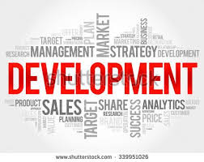

Slide 70
OTHER DISCIPLINES
The success in group effort depends upon mutual cooperation among the members of the group. Management helps in maximizing output and minimizing cost. Management is equally important at the national level.It is agent of change and economic growth.

Slide 71
OTHER DISCIPLINES
Science alone cannot sustain national development. Other important disciplines include: Arts, Law, Management sciences, International Relations. Etc.
Without the rule of law, no country is able to develop. No meaningful development without adequate reporting, information and free press. Relationship with international communities is germane.

Slide 72
Collaboration
Finally, All scientist need to colaborate to achieve greatness and get Nigeria out of economic recession and build this nation. Productivity and application of Science will reduce poverty, disease, produce more goods and services, will give jobs and consequently develop the country. No country can rise above the scientific or technological development of her Scientist, so government at all levels, Philanthropist and all commited Nigerians should fund, encourage the study and application of Science for national development. will you be part of this great move?

Slide 73

Acknowledgement
Author of knowledge the Almighty God.
iSTEAM Conveners
Adeleke University Managements led by Prof. Dayo Alao
Technical Officer Mr Emmanuel Ogungbesan
Authors in reference
You

Slide 74
References
Prof. Justice O. Emuoyibofarhe.
Olatunde, K. Victoria and Oluwagbemi J. Bisi.
IBIYEMI T.S., 2006, “Research Innovation for Sustainable development”,
www.google.com
Timescontent.com
Wikipedia

Slide 75
Thank You

